Slide 1
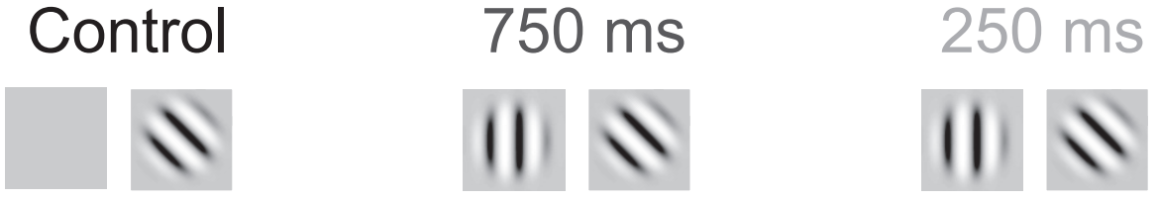
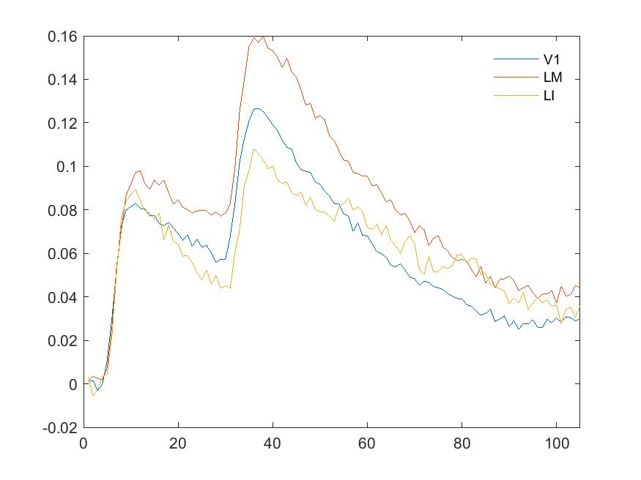
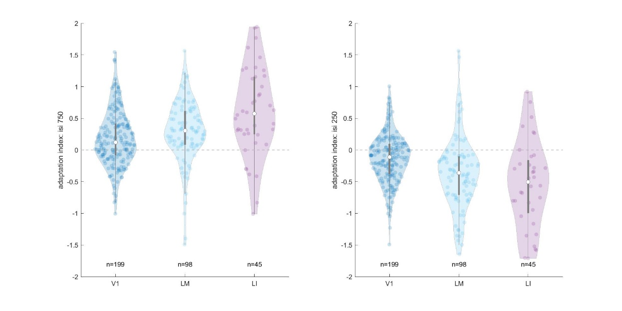
Discrepancy last time

Slide 2
What is happening when ISI=750?
Adaptation index = ( resp_targ_0deg - resp_adapter ) / resp_adapter for the same cell
Verified that responses are already averaged across trials before calculating adaptation index for a single neuron
Verified that response latency difference is small btw cells; should not affect trace.
Adjusted:
Used only neurons significantly (0.01 with Bonferroni correction) responsive to adapter
(Even so, still had to kick out neurons whose resp_adapter < 0.01)
Kicked out the same neurons before plotting average trace

Slide 3
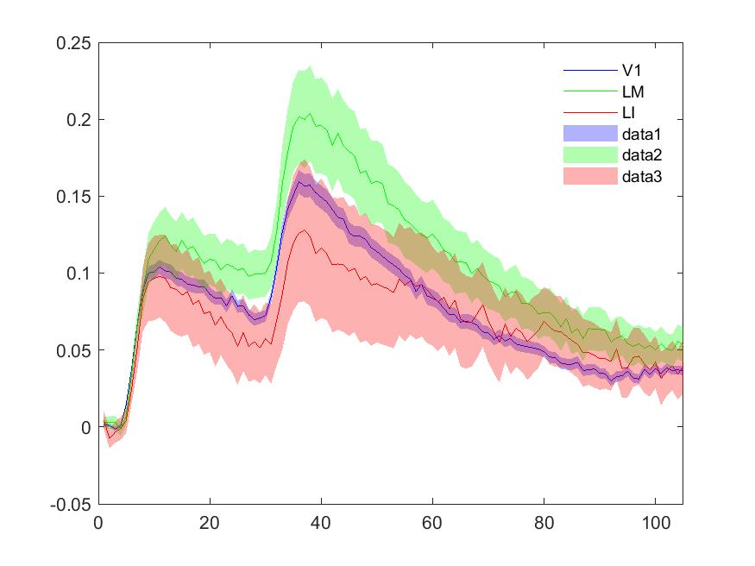
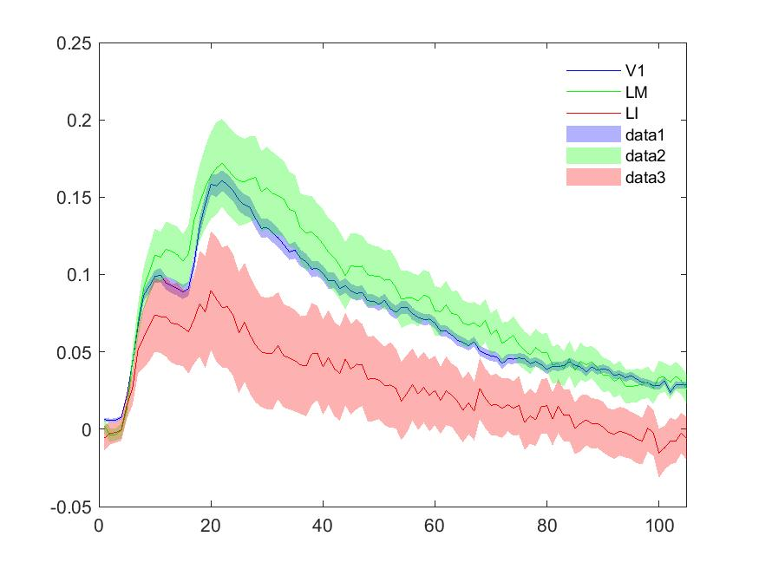
Trace of trials average across areas
adp_area_trace = -0.1479 -0.1510 -0.2750
adp_area_trace = -0.2566 -0.5083 -0.3780

Slide 4
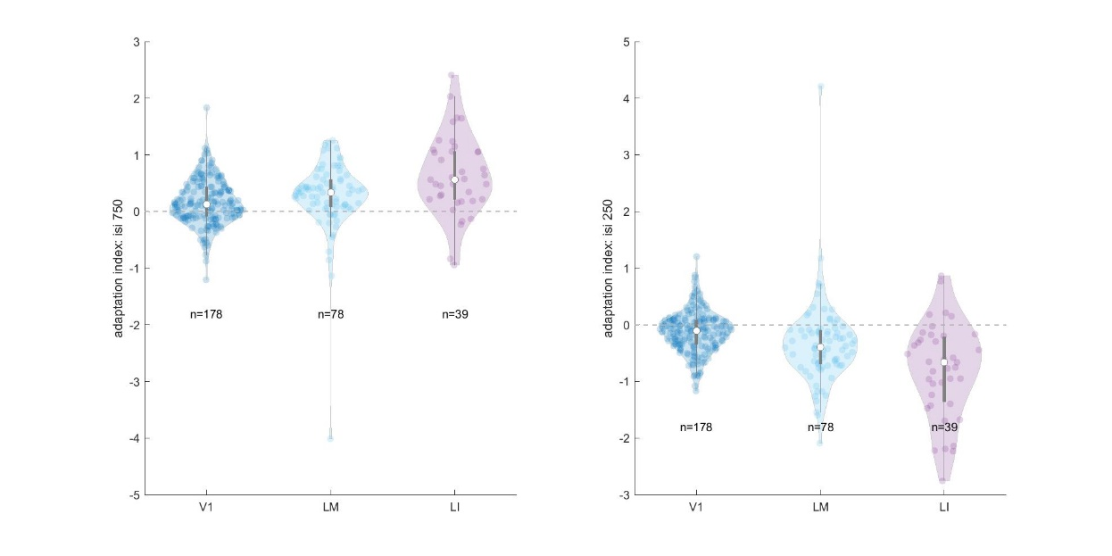
Adaptation index across areas
After getting rid of low resp_adapter
Notes:
quartiles(2)+-1.57*IQR/sqrt(length(data))

Slide 5
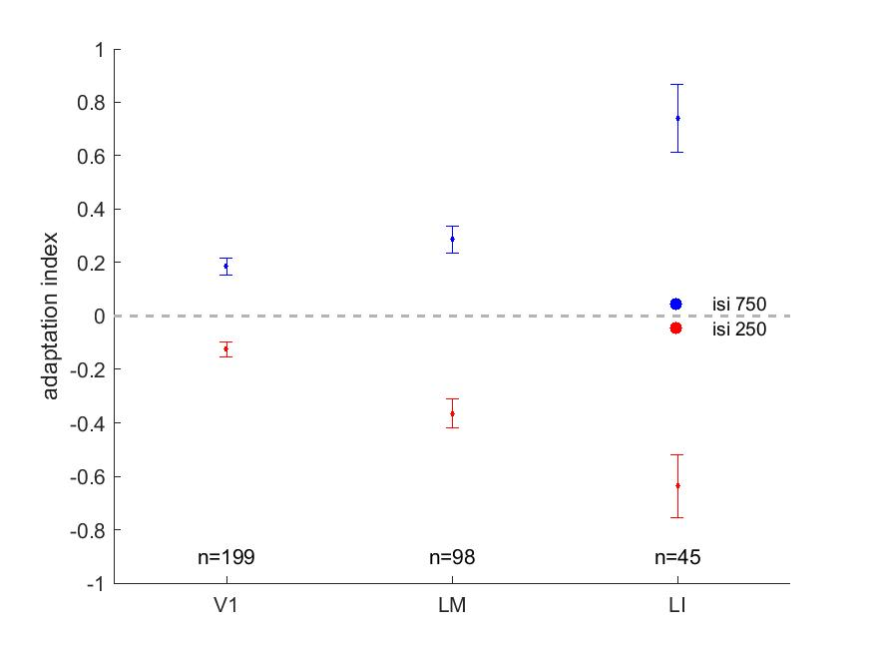
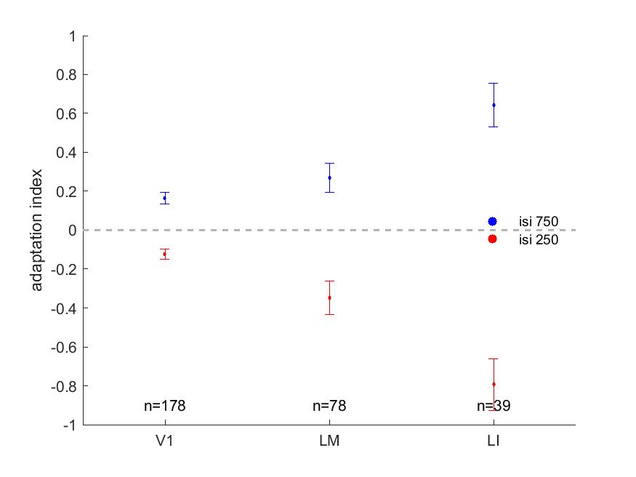
Adaptation index across areas
After getting rid of low resp_adapter

Slide 6
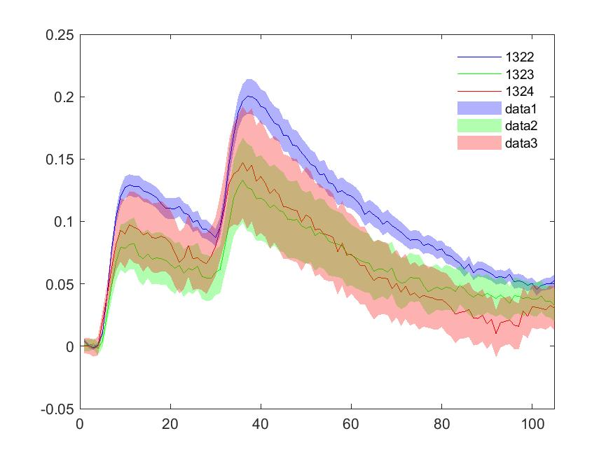
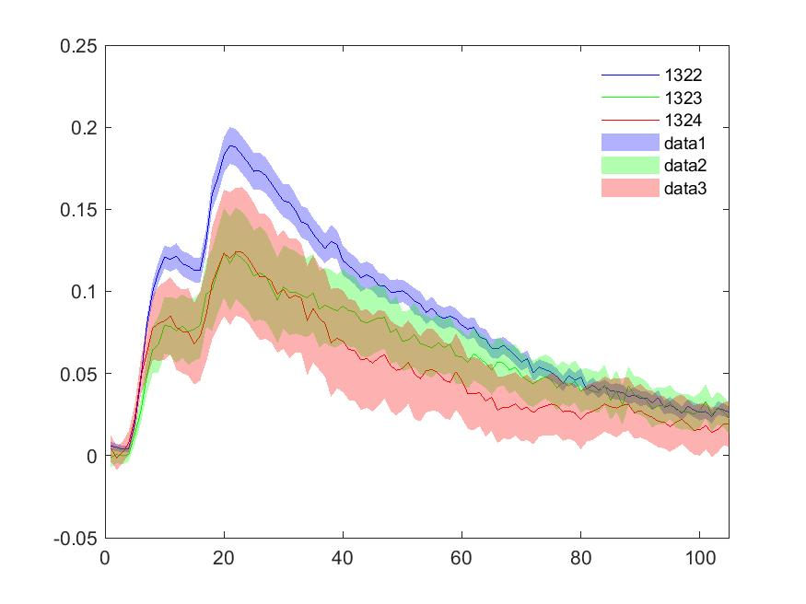
Trace of trials average across mice
adp_mouse_trace = -0.1327 -0.0643 -0.1798
adp_mouse_trace = -0.3552 -0.4525 -0.3596

Slide 7
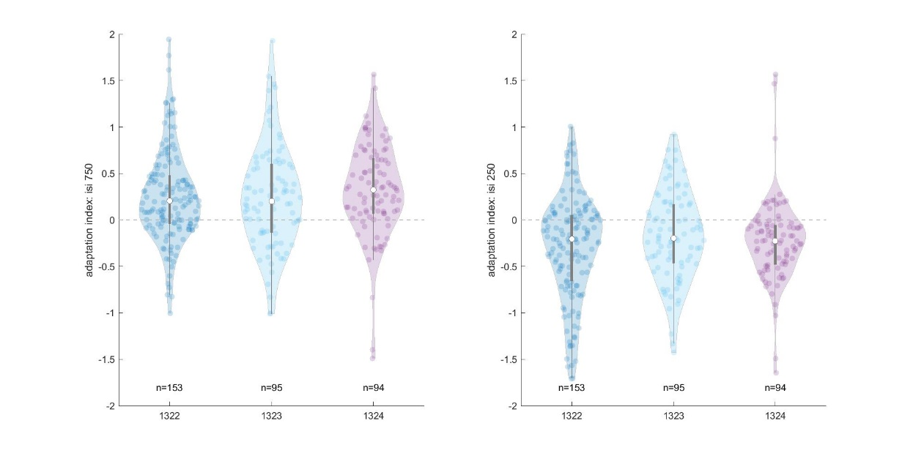
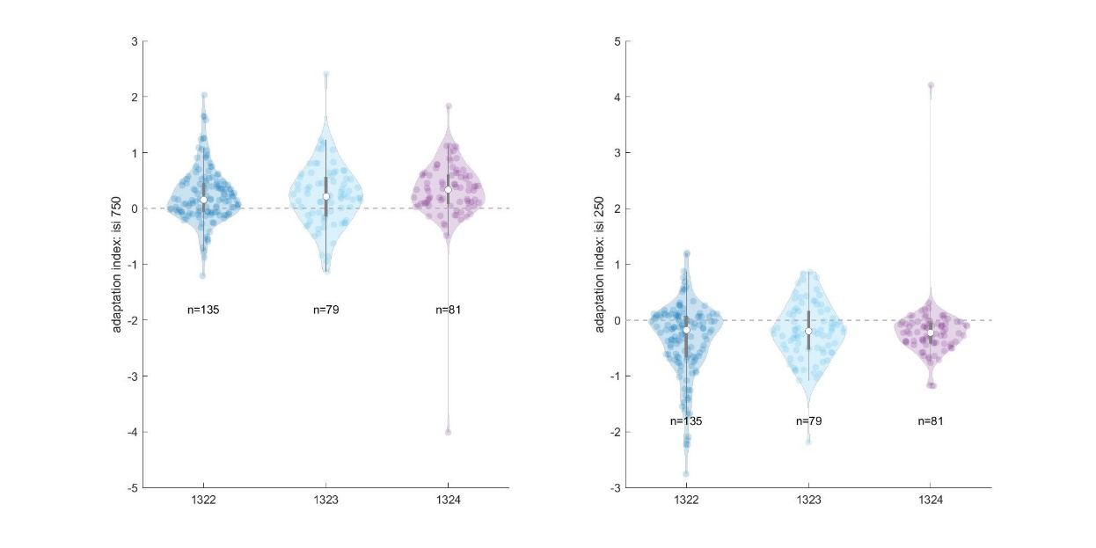
Adaptation index across mice
After getting rid of low resp_adapter

Slide 8
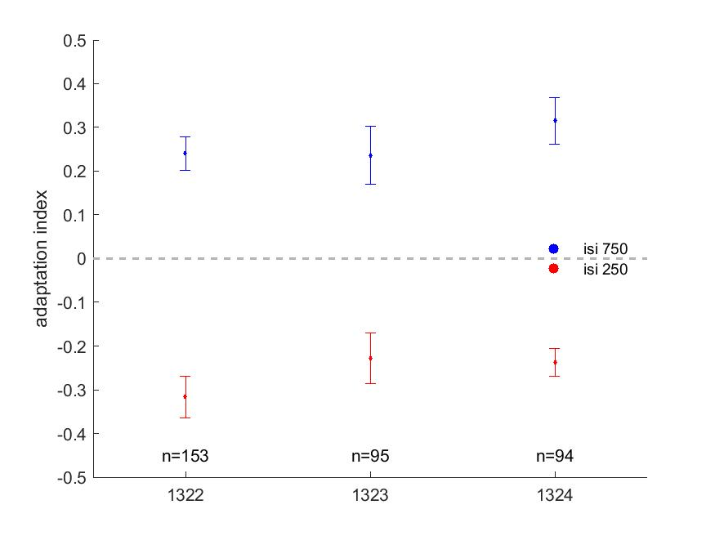
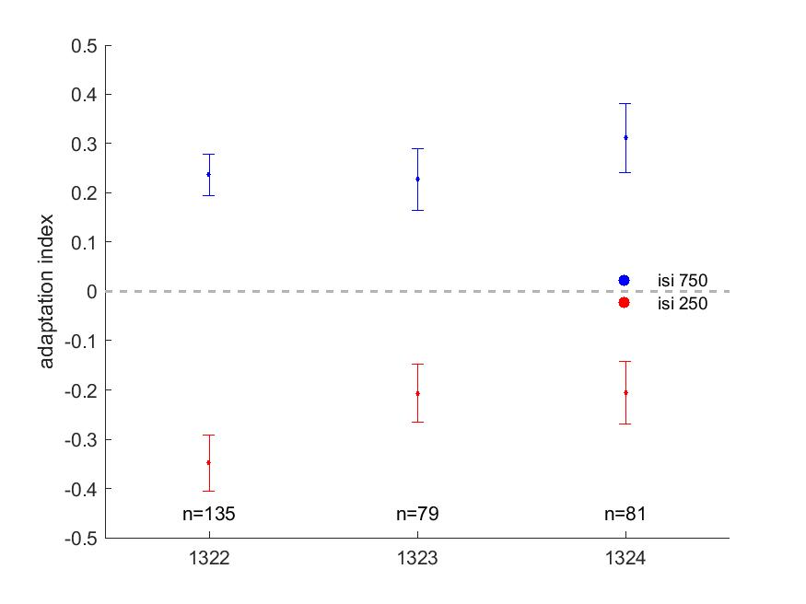
Adaptation index across mice

